Slide 1
Transformers
Understanding Machine Learning
October 2022
Felix Wick

Slide 2
Natural Language Processing (NLP)
recap:
neural language models: e.g., next-word prediction
using word embeddings as crucial building block (feature learning)
RNN/LSTM for context awareness
next challenge:
sequence-to-sequence models: e.g., machine translation
neural machine translation …

Slide 3
Sequence-to-Sequence Models

Slide 4


Encoder-Decoder Architecture
end-to-end neural network approach (RNNs in encoder and decoder)
sequences $x$ and $y$ can have different length
context (fixed-length vector)
encoder-decoder bottleneck:
need to compress all information of source sentence into fixed-length vector
→ difficult for long sentences
auto-regressive
source

Slide 5




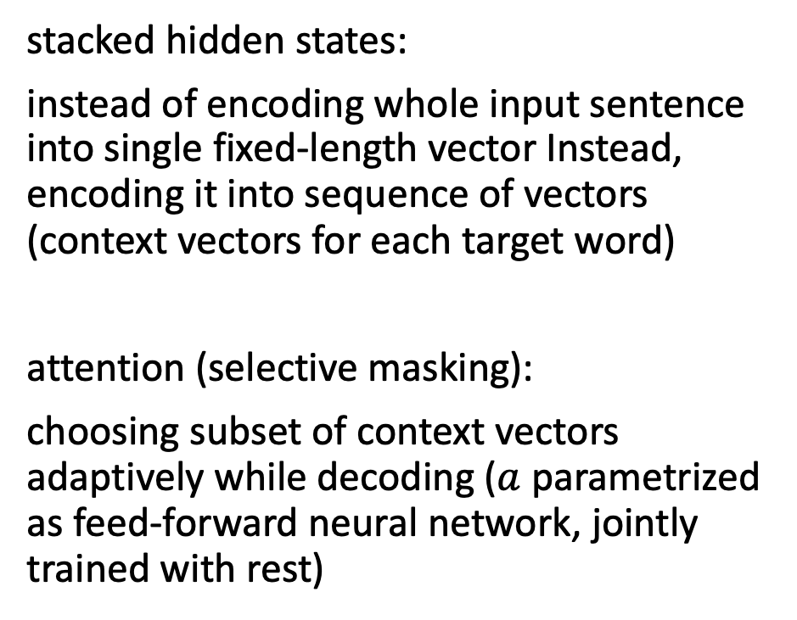
Attention to Overcome Bottleneck
stacked hidden states:
instead of encoding whole input sentence into single fixed-length vector Instead, encoding it into sequence of vectors (context vectors for each target word)
attention (selective masking):
choosing subset of context vectors adaptively while decoding ($a$ parametrized as feed-forward neural network, jointly trained with rest)
bidirectional RNN in encoder (concatenating forward and backward hidden states)
source

Slide 6
Self-Attention

Slide 7

Transformer
attention is all you need: getting rid of RNNs
replaced by multi-headed self-attention (implemented with matrix multiplications and feed-forward neural networks)
allowing for much more parallelization
→ allowing for deeper architecture (more parameters)
better long-range dependencies thanks to shorter path lengths in network (less sequential operations)
Let’s go through it step by step …
source

Slide 8

Tokenization and Embeddings
tokenization: breaking text in chunks
word tokens: different forms, spellings, etc → undefined and vast vocabulary (need for stemming, lemmatization)
character tokens: not enough semantic content
→ byte-pair encoding as compromise for tokenization
one-hot encoding on tokens → token (word) embeddings:
only before bottom-most encoder/decoder
source
source

Slide 9
Byte-Pair Encoding
data compression method used for encoding text as sequence of tokens
merging token pairs (starting with characters) with maximum frequency
continue merging until defined fixed vocabulary size (hyperparameter) is reached
common words encoded as single token
rare words encoded as sequence of tokens (representing word parts)
aaabdaaabac
ZabdZabac
Z=aa
ZYdZYac
Y=ab
Z=aa
XdXac
X=ZY
Y=ab
Z=aa
example from wikipedia

Slide 10

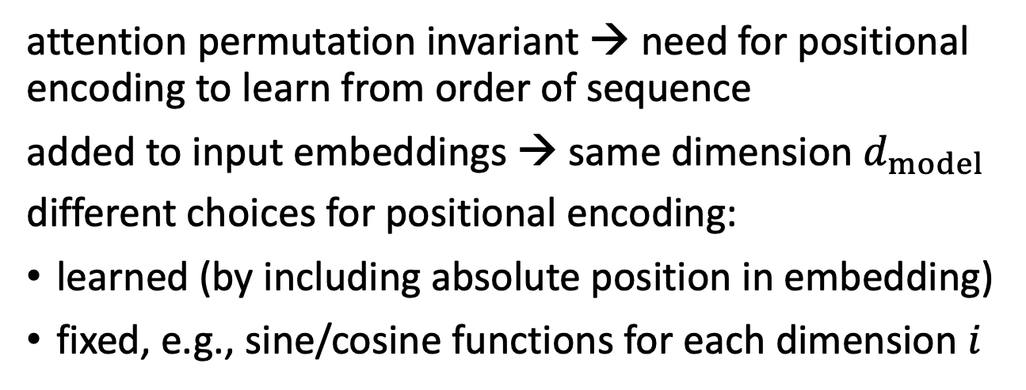
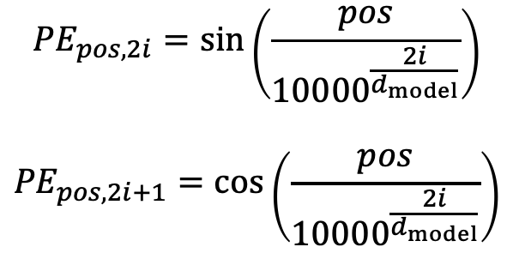
Positional Encoding
attention permutation invariant → need for positional encoding to learn from order of sequence
added to input embeddings → same dimension $d_{model}$
different choices for positional encoding:
learned (by including absolute position in embedding)
fixed, e.g., sine/cosine functions for each dimension $i$
$${PE}_{pos,2i}=\sin\left(\frac{pos}{{10000}^{\frac{2i}{d_{model}}}}\right)$$
$${PE}_{pos,2i+1}=\cos\left(\frac{pos}{{10000}^{\frac{2i}{d_{model}}}}\right)$$
source
source

Slide 11


Encoder and Decoder Stacks
output of encoders/decoders fed as input to next ones
idea of depth: providing redundancy (rather than increasingly sophisticated abstraction, like, e.g., in CNN)
source
source

Slide 12

Skip Connections and Layer Normalization
skip connections and layer normalization for each sub-layer
skip connections improve robustness:
against failing of individual attentions blocks
by preserving input (attention to most recent word)
source
source

Slide 13

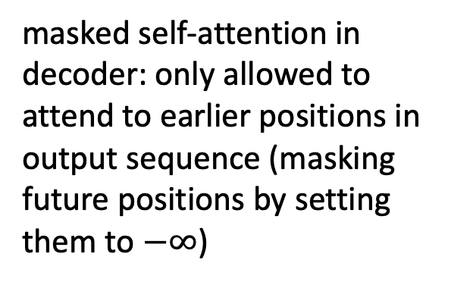
Self-Attention
evaluating other input words in terms of relevance for encoding of given word
masked self-attention in decoder: only allowed to attend to earlier positions in output sequence (masking future positions by setting them to $−∞$)
source
source

Slide 14


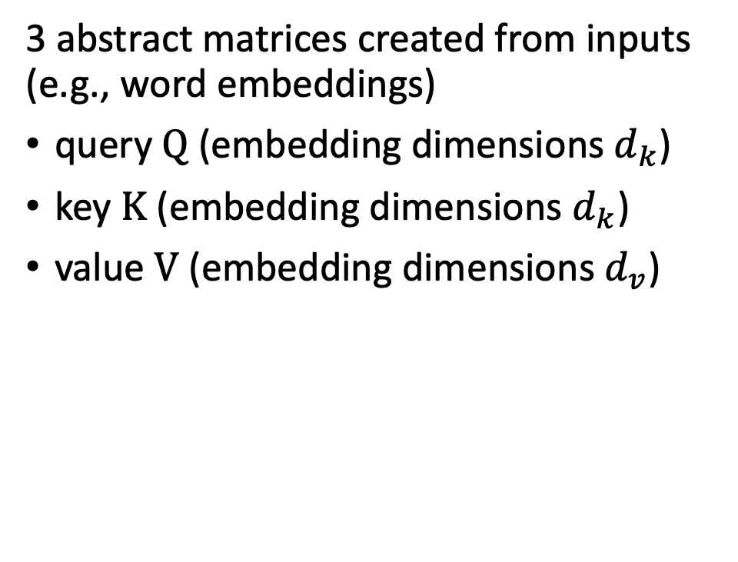
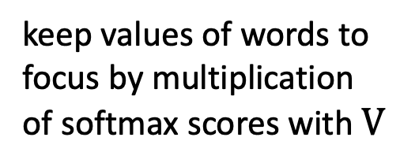
Scaled Dot-Product Attention
3 abstract matrices created from inputs (e.g., word embeddings)
query $Q$ (embedding dimensions $d_{k}$)
key $K$ (embedding dimensions $d_{k}$)
value $V$ (embedding dimensions $d_{v}$)
keep values of words to focus by multiplication of softmax scores with $V$
scoring each of the key words with respect to query word
source

Slide 15


Multi-Head Attention
multiple heads: several attention layers running in parallel
different heads can pay attention to different aspects of input (multiple representation sub-spaces)
source
source

Slide 16

Involved Matrix Calculations
parameters to be learned
source

Slide 17

Position-Wise Feed-Forward Networks
for each encoder or decoder layer: identical feed-forward network independently applied to each position
creating multi-word features from (self-)attention outputs (selectively masked words)
two network layers
source
source

Slide 18
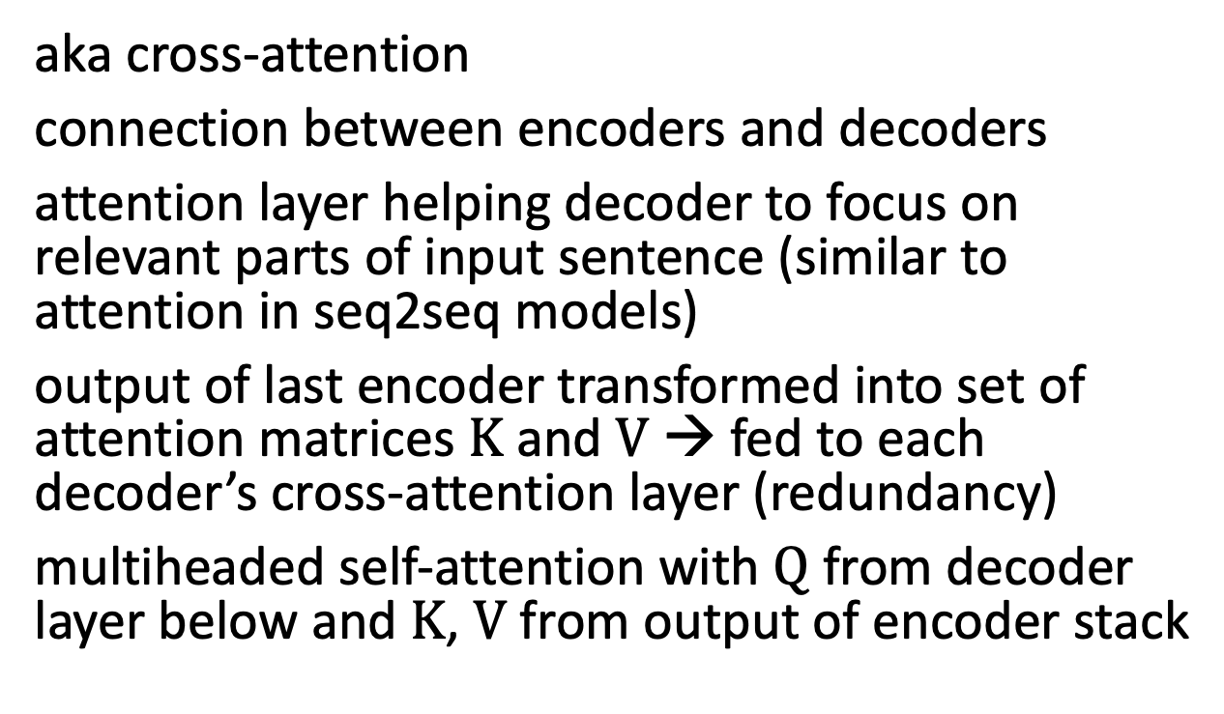
Encoder-Decoder Attention
aka cross-attention
connection between encoders and decoders
attention layer helping decoder to focus on relevant parts of input sentence (similar to attention in seq2seq models)
output of last encoder transformed into set of attention matrices $K$ and $V$ → fed to each decoder’s cross-attention layer (redundancy)
multiheaded self-attention with $Q$ from decoder layer below and $K$, $V$ from output of encoder stack
source

Slide 19

De-Embedding and Softmax
n: maximum sequence length
N: vocabulary size
d_model: embedding dimensions
conversion of final decoder output to predicted next-token probabilities for output vocabulary
de-embedding: linear transformation (matrix multiplication / fully connected neural network layer)
softmax: transformation to probabilities
source
source

Slide 20

Sequence Completion
for each step (iteratively), choose one output token (e.g., greedily picking the one with highest probability or beam search) to add to decoder input sequence → help generating next token
prompt: externally given initial sequence for running start and context on which to build rest of sequence (prompt engineering)
auto-regressive
source
source

Slide 21
Inductive Bias
time series forecasting as example that can be approached with all three of these deep learning methods:
automating manual assumptions of traditional methods or shallow ML algorithms with feature engineering
but often need to include effects from exogenous variables (more than pure auto-correlation)
CNN:
translation invariance and locality via convolutions
grid-like structures (e.g., computer vision)
RNN:
temporal invariance and locality via Markov property
sequential structures (e.g., NLP)
self-attention/transformer:
permutation invariance
also sequential structures (e.g., NLP), but few assumptions (give up Markov property of RNN) → universal and flexible architecture, but prone to overfitting → requiring lots of data

Slide 22
Large Language Models

Slide 23

Key Features
transfer learning (advantage of deep learning, also prominent for CNNs):
unsupervised (or rather self-supervised) pre-training on massive data sets
subsequent discriminative (supervised) fine-tuning on specific tasks and data sets (by adapting parameters or/and adding layers )
typical transformer architectures:
decoder-only: outputting one token at a time (auto-regressive)
encoder-only: incorporating context of both sides of token (representation)
semi-supervised
source

Slide 24
Example for Encoder-Only Transformers
BERT (Bidirectional Encoder Representations from Transformers, by Google, used in Google search engine):
stack of transformer encoders
outputting representation (embedding) to be used/fine-tuned in specific tasks and data sets
bidirectional: jointly conditioning on both left and right context
pre-trained in self-supervised manner on massive data sets for:
language modeling (masked tokens to be predicted from context)
next sentence prediction (predict probability of next sentence given first sentence)

Slide 25
Example for Decoder-Only Transformers
GPT (Generative Pre-trained Transformer, by OpenAI) series:
stack of transformer decoders → auto-regressive language model
generative pre-training: unsupervised/self-supervised training (generating text, i.e., next-word predictions) on massive web scrape data sets
GPT-3: 175 billion parameters (Google’s PaLM: 540 billion parameters, …)
GPT: discriminative fine-tuning on specific tasks (e.g., summarization, translation, question-answering) with much smaller data sets
GPT-2, GPT-3: also zero- or few-shot learning (no parameter or architecture updates)

Slide 26

Multi-Task Learning
no fine-tuning:
different tasks with same input data, no task-specific training data
text generation in response to priming with arbitrary input, adapting to style and content of conditioning text
meta-learning: ask to perform new task at test time (based on high-level abstractions learned from pre-training)
→ prompt programming
GPT-3

Slide 27

Prompting
nice example for capabilities of large language models and prompting: interview with Google’s LaMDA
LaMDA (Language Models for Dialog Applications):
system for generating chatbots
trained on dialogue data
decoder-only transformer language model
not sentient, but impressively capable in learning language: leading questions to suggestible statistical language model
source

Slide 28
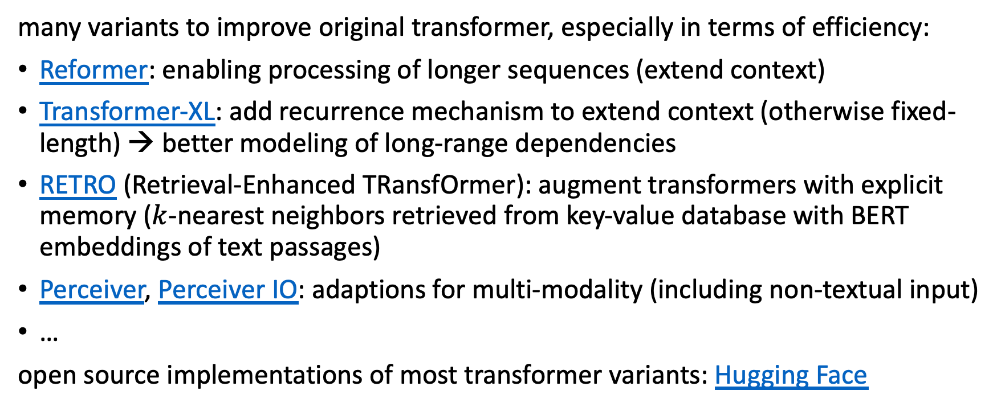
Transformer Variants
many variants to improve original transformer, especially in terms of efficiency:
Reformer: enabling processing of longer sequences (extend context)
Transformer-XL: add recurrence mechanism to extend context (otherwise fixed-length) → better modeling of long-range dependencies
RETRO (Retrieval-Enhanced TRansfOrmer): augment transformers with explicit memory ($k$-nearest neighbors retrieved from key-value database with BERT embeddings of text passages)
Perceiver, Perceiver IO: adaptions for multi-modality (including non-textual input)
…
open source implementations of most transformer variants: Hugging Face

Slide 29
Vision Transformer (ViT)

Slide 30

Image Classification with ViT
formulation as sequential problem:
split image into patches and flatten → use as tokens
produce linear embeddings and add positional embeddings
processing by transformer encoder:
pre-train with image labels
fine-tune on specific data set
source

Slide 31



Attention vs Convolution
global attention in lower layers (unlike local receptive fields in CNNs)
fewer inductive biases in ViT than in CNN:
no translation invariance
no locally restricted receptive field
Since these are natural for vision tasks, ViTs (conceptionally) learn them from scratch. → ViTs need way more data.
but can lead to beneficial effects (e.g., global attention in lower layers)
see MLP-Mixer results: given enough data, plain multi-layer perceptrons can learn crucial inductive biases
trainable position embedding:
source
added due to permuation invariance of attention

Slide 32


Examples for Combination of Vision and Text
CLIP (Contrastive Language-Image Pre-training):
natural language prompting: zero-shot transfer
e.g., for object recognition
DALL-E (blend of WALL-E and Salvador Dalí):
generate images from text descriptions
decoder-only transformer autoregressively modeling text and image tokens as single stream of data
source
generally, multi-modal learning as next generalization step of ML models (e.g., Google’s Pathways)
transformers good candidate (universal and flexible architecture, little task-specific inductive bias)

Slide 33
Literature
papers:
seq2seq
neural machine translation
transformer
formal transformers
Vision Transformer
blogs/videos:
visualization of neural machine translation
The Illustrated Transformer
transformers summary
analysis of LaMDA interview

Slide 34

Programming for Everyone
code generation in response to natural language prompt
Codex:
descendant of GPT-3
fine-tuned on publicly available code from GitHub
productionized as GitHub Copilot

